Slide 1
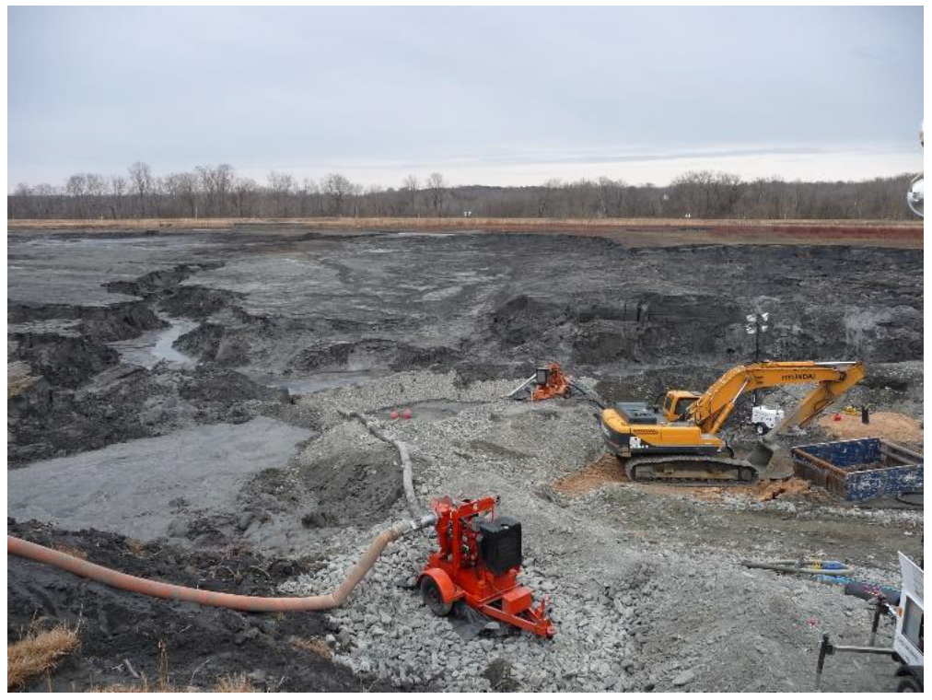
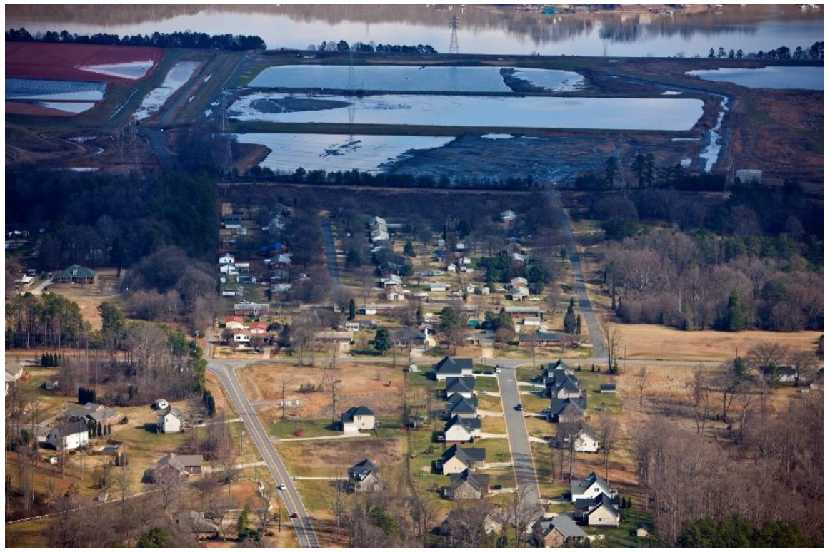
Modeling Groundwater Contamination at Coal Ash Dumps
Faculty Mentor: Rachel Nethery
Student Mentor: Luli Zou

Slide 2
Toxic contaminants in coal ash from power plants often contaminate groundwater
Coal-fired power plants in the US produce around 100 million tons of coal ash annually
Coal ash contains toxic chemicals including carcinogens and metals that can impair children’s developing brains
For much of the last century, power companies dumped coal ash into unlined landfills and ponds, allowing it to leak into groundwater
EPA’s 2015 Coal Ash Rule established groundwater monitoring requirements for coal ash dumps, and monitoring data made available to the public starting in March 2018

Slide 3
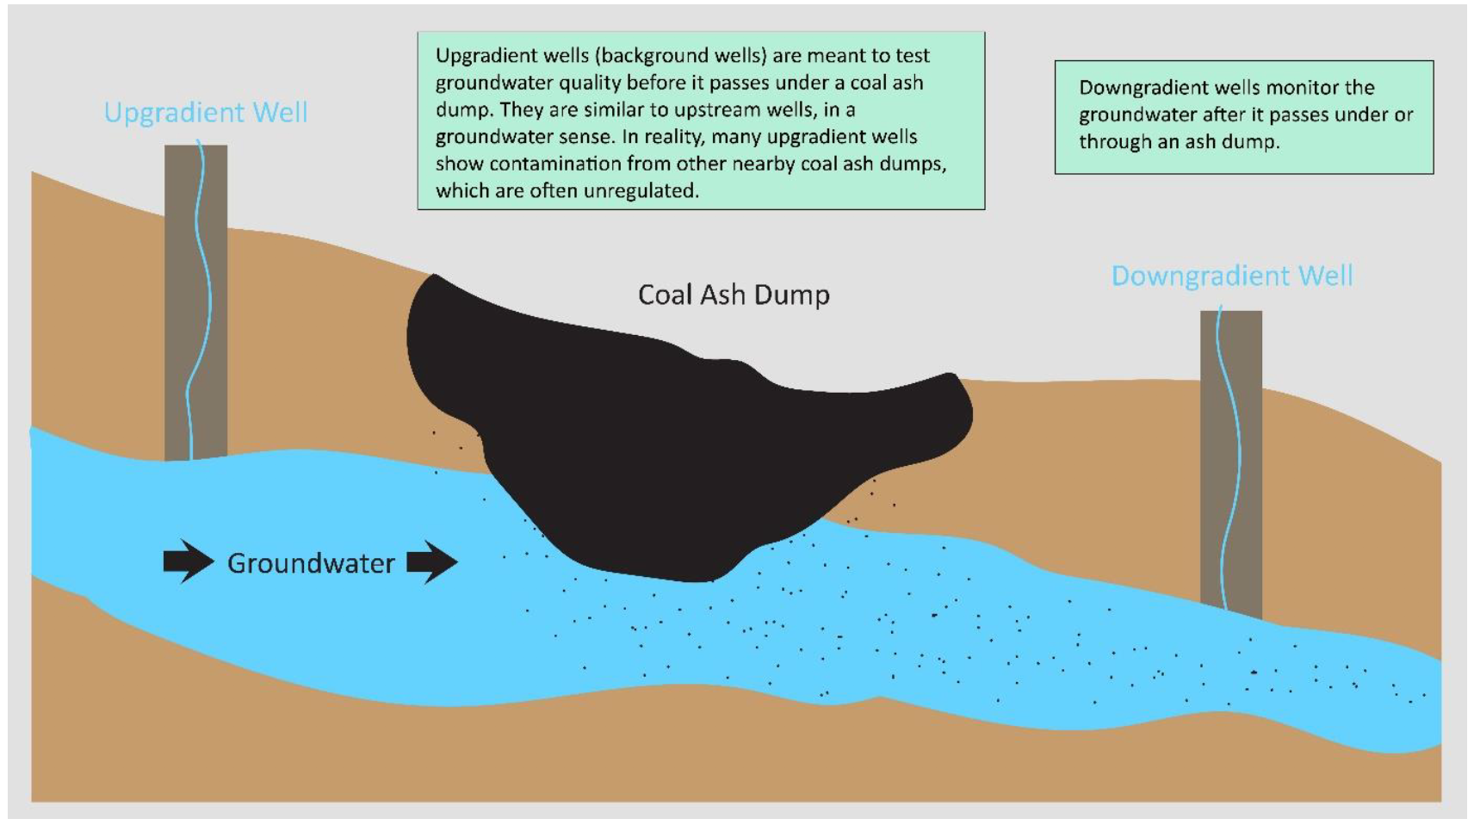
Groundwater monitoring
Question: How much chemical contamination of groundwater is being caused by each coal ash dump?
Must account for the fact that many chemicals are naturally occurring and their natural levels vary over space

Slide 4
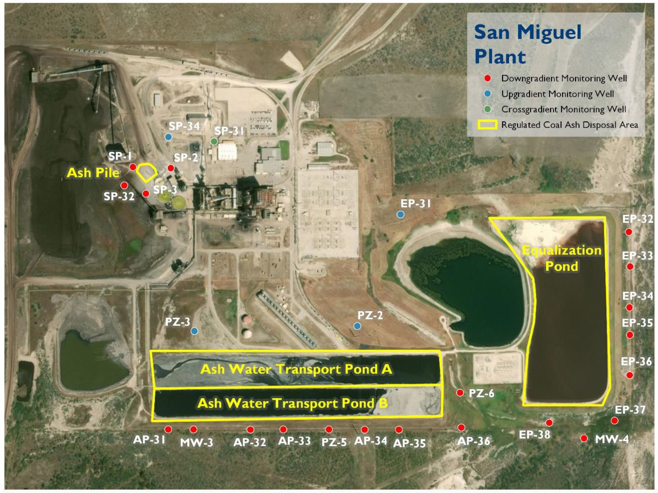
Groundwater monitoring

Slide 5
Data problem
To estimate the amount of arsenic contamination caused by a coal ash dump, we might want to do:
Downgradient arsenic-Upgradient arsenic
However, this may be inaccurate due to occasional contamination of “upgradient” wells by retired/unregulated ponds
Goal of this project: identify contaminated upgradient wells and seek to “correct” their measurements

Slide 6
Identifying and correcting contaminated upgradient well measurements
Do measurements at a small number of “upgradient” wells look fishy compared to other upgradient wells at the same site?
Do measurements at an “upgradient” well look fishy compared to all other upgradient wells within a 100 mile radius?
If we assume that natural levels of each chemical in groundwater follow some distribution (based on empirical distribution of measurements at non-contaminated upgradient sites) then we can impute corrected measurements for contaminated wells from this distribution.

